Slide 1
Online Immediate Commitment Job Scheduling A Machine Learning Approach
Philip Varghese Modayil
Matr No: 229225

Slide 2

Cloud Computing: An Introduction
Simply put, cloud computing is the delivery of computing services—including servers, storage, databases, networking, software, analytics, and intelligence—over the Internet (“the cloud”) to offer faster innovation, flexible resources, and economies of scale.
Infrastructure as a service (IaaS) is a type of cloud computing service that offers essential compute, storage, and networking resources on demand, on a pay-as-you-go basis.

Slide 3
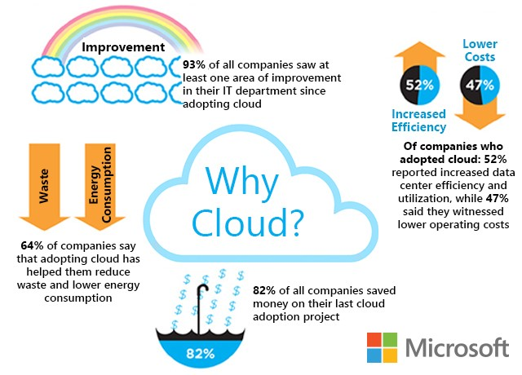
System providers rent out infrastructure (usually but not exclusively computing power) to clients in the Infrastructure-as-a-Service business model of cloud computing.

Slide 4
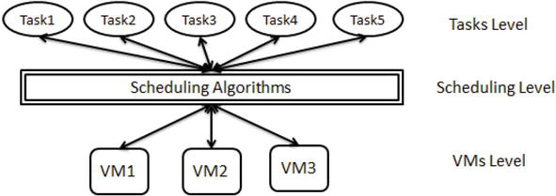
In order to achieve a range of scheduling goals, cloud computing requires a scheduler (broker) to work out how to best assign a limited number of resources to incoming activities and applications (e.g., monetary cost, computational cost, makespan, availability, reliability, response time, resource utilization, energy consumption, etc.).
DOI: 10.5772/intechopen.86873

Slide 5
Terminologies
Immediate Commitment: also known as commitment on arrival, is the most powerful and ideal type of commitment: we must determine whether or not to execute a job soon after it is submitted.
The agreement is binding once a customer has rented infrastructure from the service provider.
Legality: a job scheduling is legal if completion time of job ≤ deadline of job.
Slack: is the difference between completion time of the job if it is started on arrival and its deadline.

Slide 6
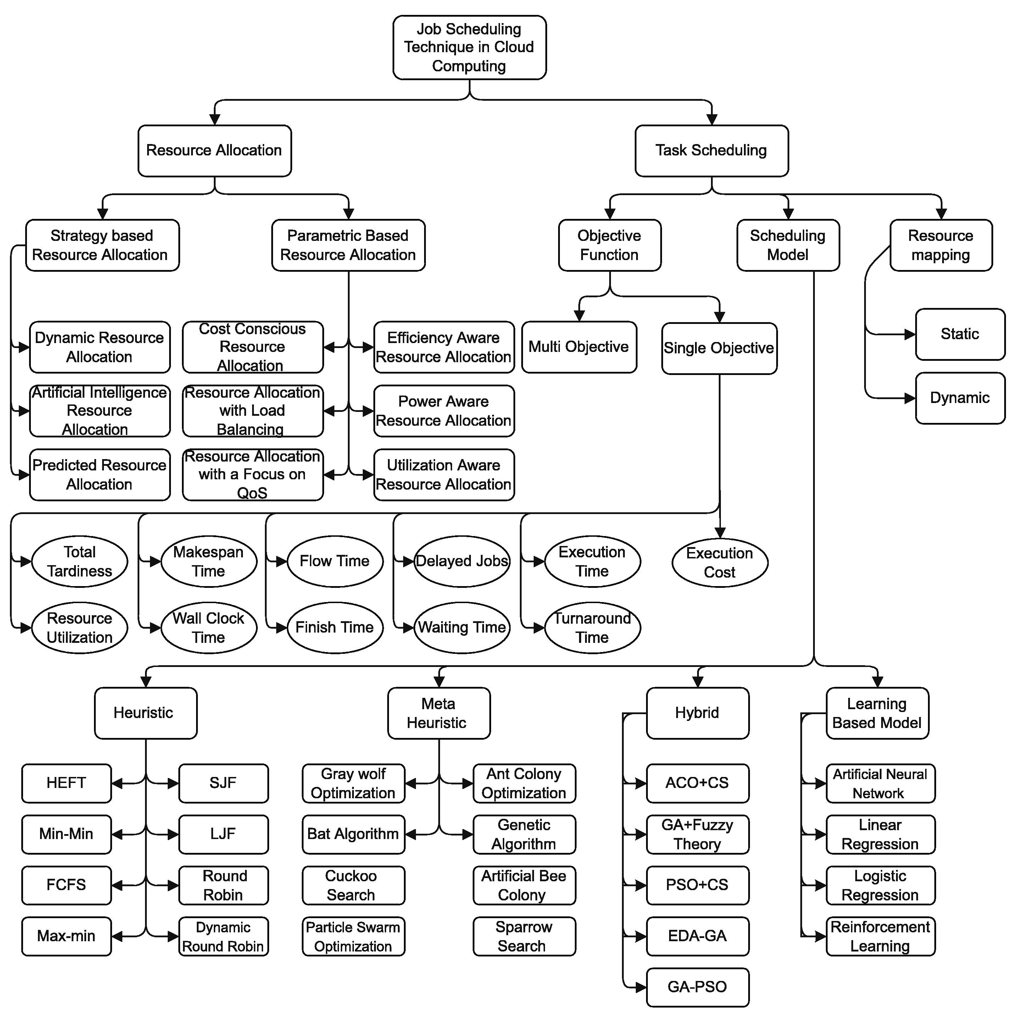
Problem Scenario
This project aims at:
studying the possibilities for the machine to learn something from the job scheduling environment to maximize machine utilization.
The machine should then be able to accept or reject the incoming job with immediate commitment, based on its judgement of the current states of the machines and the properties of the incoming job.

Slide 7
Since the Immediate commitment job scheduling problem is an extremely random process it is not feasible to identify any pattern from it. Hence, conventional machine learning approaches cannot be deployed. Since the job scheduling problem can be considered as a game between an adversary and online player, it makes sense for the machine to consider multiple scenarios of the game and learn a strategy to predict the next action based on the current states. Hence, reinforcement learning is the best fit for this approach.

Slide 8
Prior Knowledge
This paper teaches us that the jobs need to be judged based on a rejection criterion even if it is legal to accept it. S. Jamalabadi, C. Schwiegelshohn, and U. Schwiegelshohn, “Commitment and slack for online load maximization,” in Proceedings of the 32nd ACM Symposium on Parallelism in Algorithms and Architectures, 2020, pp. 339–348.
The majority of methods in Reinforcement Learning rely on well-known benchmarks from the OpenAI gym library.

Slide 9
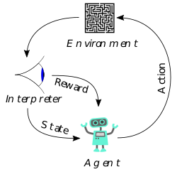
Reinforcement Learning Approach
As we are expecting the machine to decide on the action taken, there is no hard rejection rule given.
The reward choice in this project was a dense reward approach where we give reward for the action taken at each step.

Slide 10
Determining Quality Of Incoming Job
Since the aim is to maximize machine utilization, we should always try to get higher processing time jobs to be scheduled on the machine. Hence, non-profitable jobs need to be rejected to make room for higher processing time jobs.
Profitability: a simple logical method to determine profitability of accepting a job to a system.

Slide 11
Steps To Determine Profitability
Update machine states with current remaining load and arrange in descending order.
Calculate mean of the current remaining load (mean_load)
pos_mean = position of first machine with current remaining load less than mean_load.
Consider least loaded machine m’ to accept the incoming job J.
Rearrange the machine states list in descending order.
leap_pos = new position of the machine m’ in the machine states list.
threshold = number of machines – pos_mean. (from rear end)
Profitable = If leap_pos < threshold: TRUE else: FALSE

Slide 12
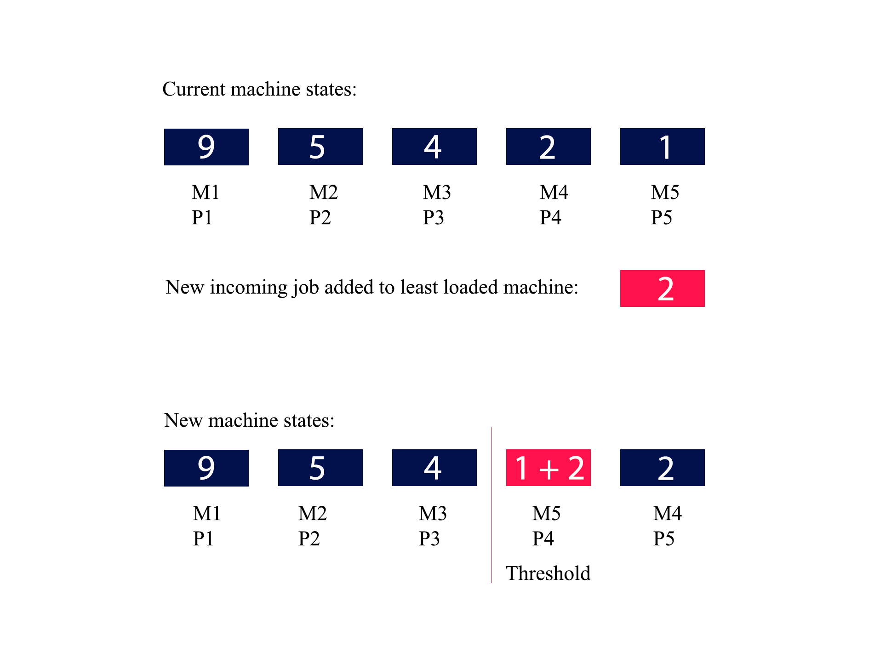

Slide 13
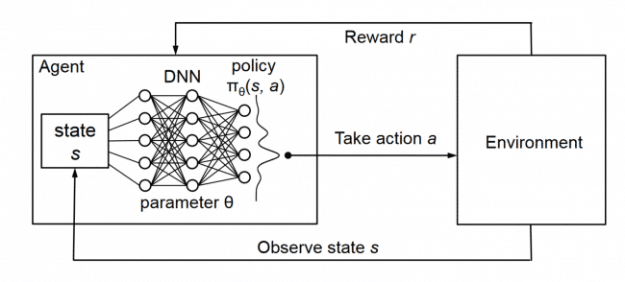
Reinforcement Learning Algorithm
The reinforcement learning algorithm used here is the DQN algorithm.
The usage of DQN is mostly for
Deterministic environments where, if we had a function Q:StateXAction->R that tells us what the reward we shall get then it is possible to create a policy that maximizes our rewards.

Slide 14
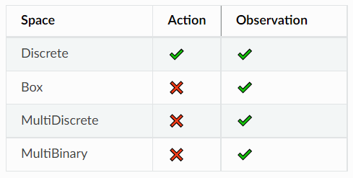
This is parallel with our problem and hence we have chosen to use DQN algorithm even though our environment is highly random.

Slide 15
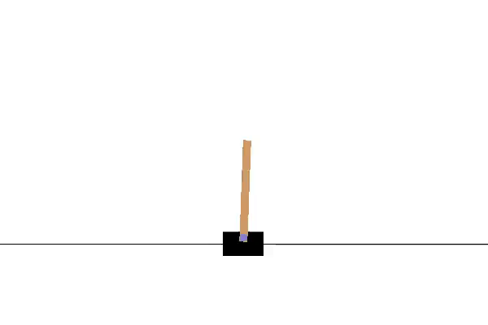
OpenAI GYM
Open source interface to reinforcement learning tasks. The gym library provides an easy-to-use suite of reinforcement learning tasks.
CartPole-v1 environment : maximize number of stable instances.

Slide 16
Personalizing CartPole-v1 Environment
We can draw parallels between CartPole-v1 and our scenario.
We need to maximize the number of profitable actions taken in one whole run of the job file.
Step function:
Read job
Update machine states
Determine profitability
Update observation space
Take random action
Give reward

Slide 17
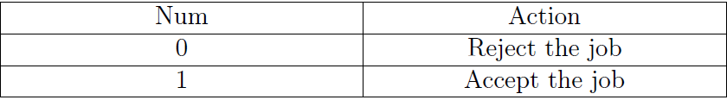
LEARNING ENVIRONMENT AND SET UP
Action Space:

Slide 18
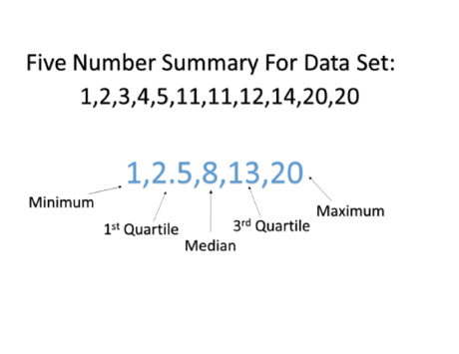
Observation Space: The current load on the machines and the incoming job properties need to be considered.
Problem: As the number of machines vary the observation space varies. No boundedness.
Solution: Five number summary / box plot representation.

Slide 19
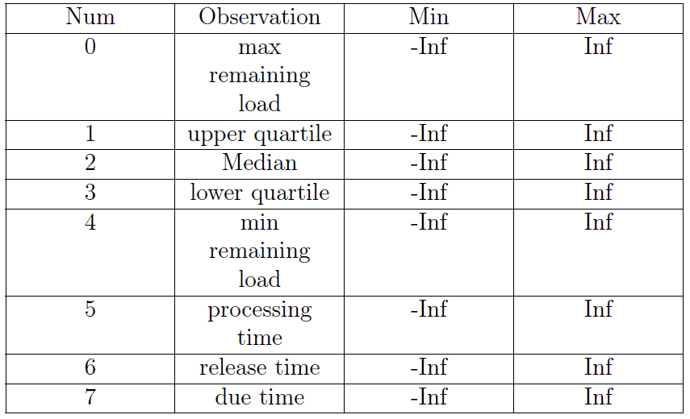

Slide 20
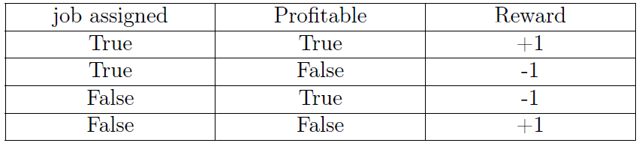
Reward Scheme: Maximize profitable actions.

Slide 21
Training
Used stable baselines 3 libraries for Reinforcement Learning implementation.
Trained on 10 days’ of data.
Each day’s data contains 990 text files with over 10378 job details in each of them. Hence a total of 9900 different scenarios were considered while training.
The environment was trained for 130 million timesteps (120 hours) and a model generated at each 1 millionth timestep.

Slide 22
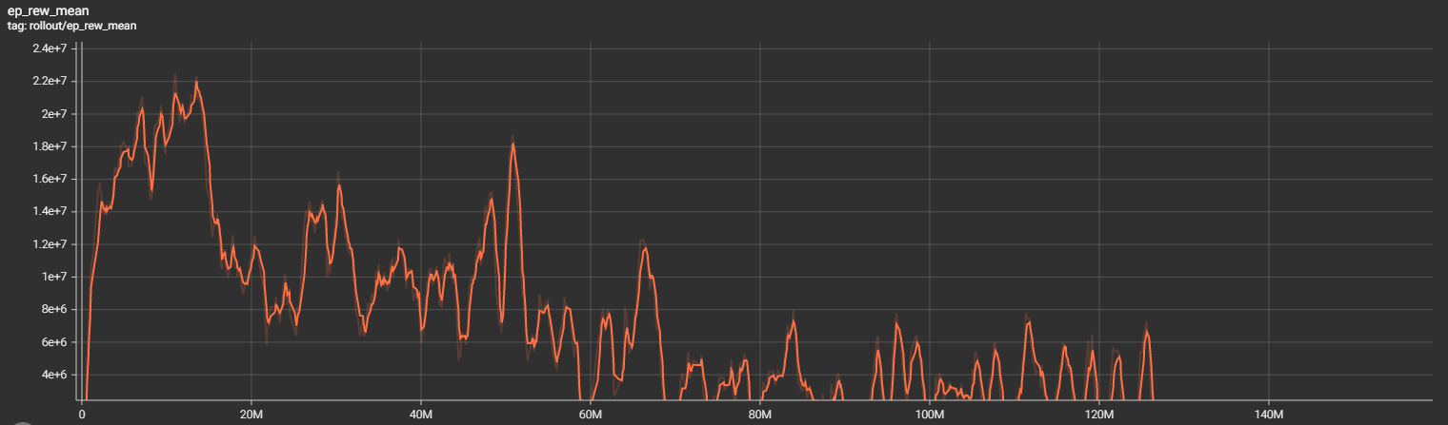
The peak reward was obtained at the 13.53 millionth timestep and hence we shall regard the model generated at 14 millionth timestep to be the optimal model obtained from the training.
Training reward mean

Slide 23
Testing And Results
With the saved model in “14000000” zip folder we have run the testing on the files of Day 11 for number of machines (10,20,30,..,200).
Parameters included in the test results are:
Accepted Load: It is the total sum of job processing times accepted by the system of machines.
Rejected Load: It is the total sum of job processing times rejected by the system of machines.
Available Resources: min(total submitted load (accepted load + rejected load) ,number-of-machines x latest-completion-time-of-a-job-in-any-of-the-machines)

Slide 24
Performance Ratio: Load processed in an optimal scenario / Load processed by our algorithm(Accepted load)
Load Processed in an optimal scenario: max(Available Resources Greedy, Available Resources ML)
We should note that higher the Performance Ratio worse the performance of our algorithm.

Slide 25
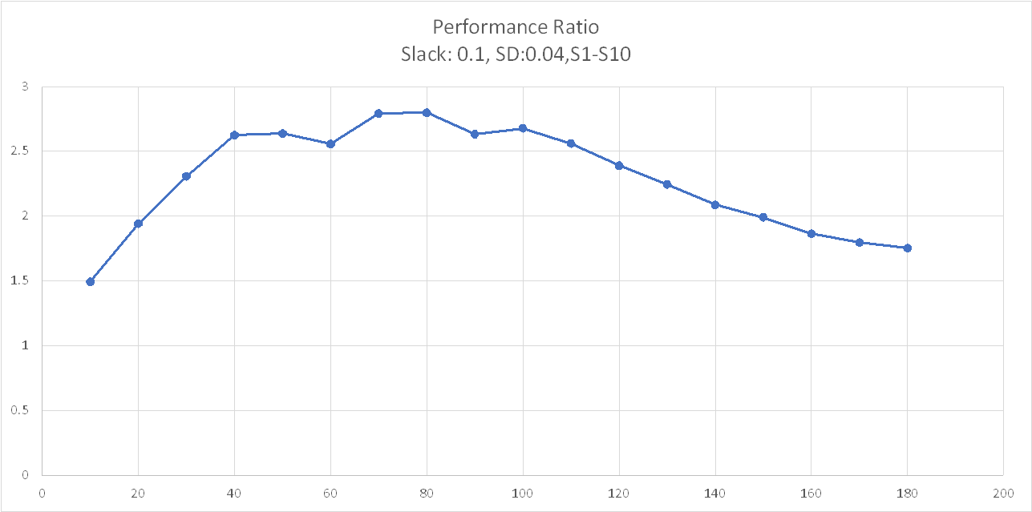
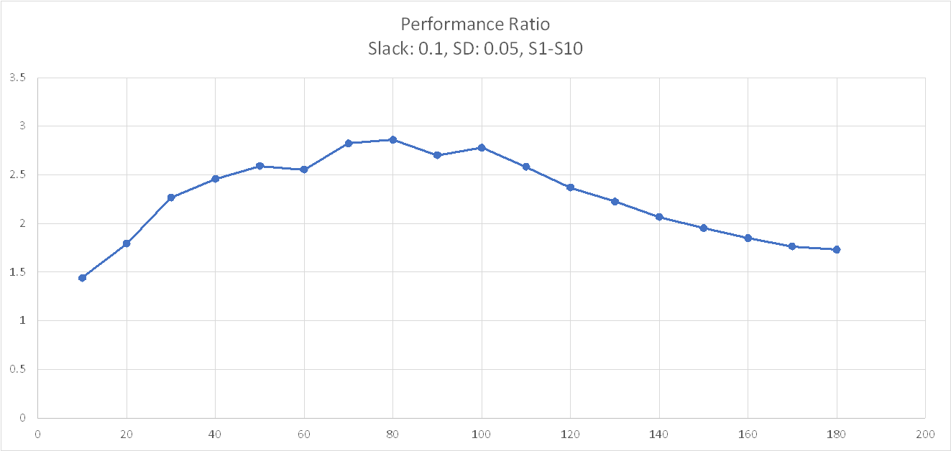

Slide 26
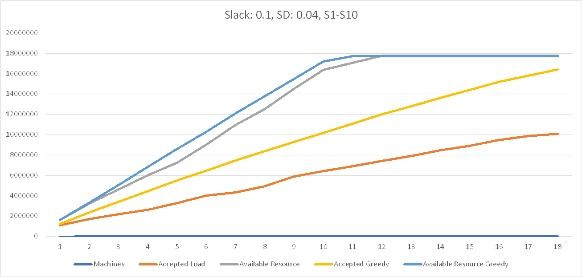
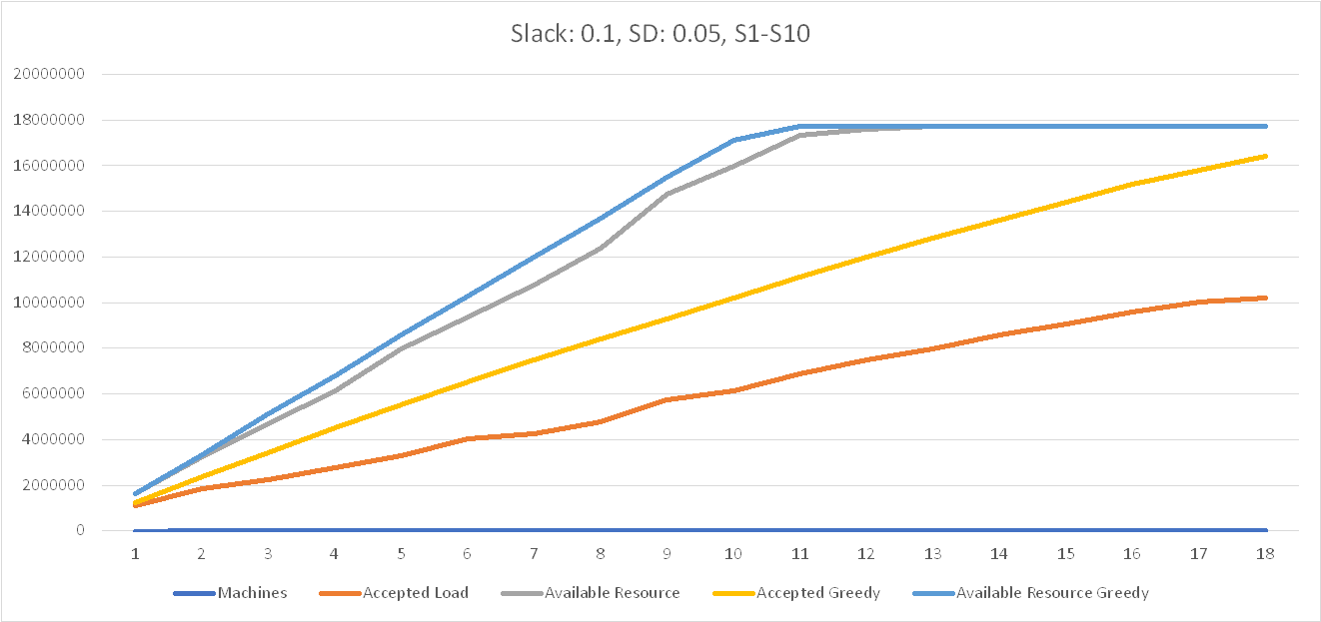

Slide 27
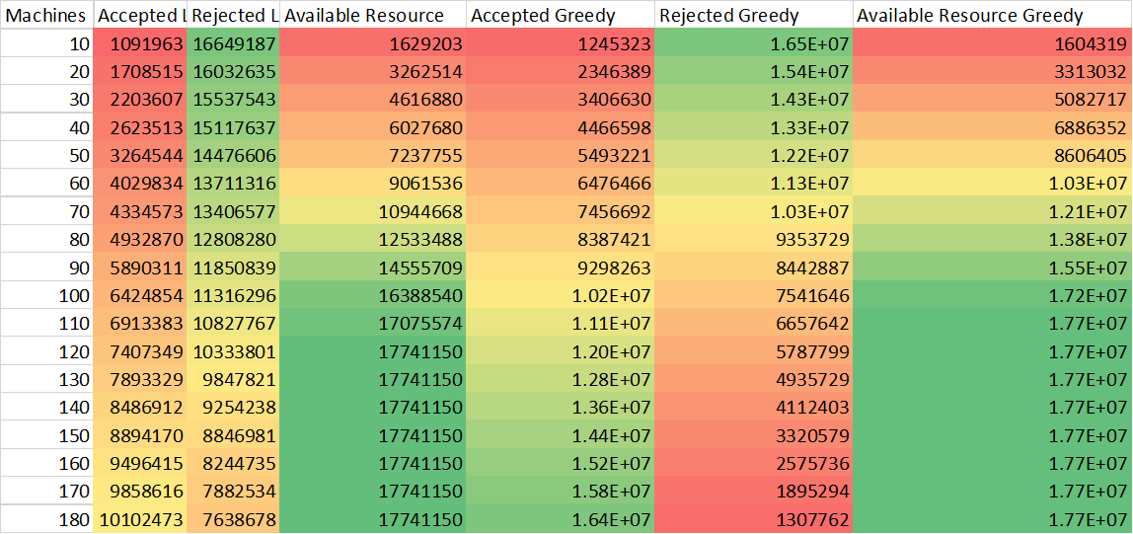
Observations
We can observe that, as the available resources increases, greedy best fit algorithm out performs our machine learning approach by large (Red Colour: lowest, Green Colour: Highest).

Slide 28
However, for less resources the ML approach is comparable to the greedy best fit algorithm.
We can make the observation that the performance ratio of the ML approach for number of machines 30-140 is quite bad. Whereas, the performance ratio of the ML approach is in the satisfactory range for number of machines 10,150,160,170,180.

Slide 29
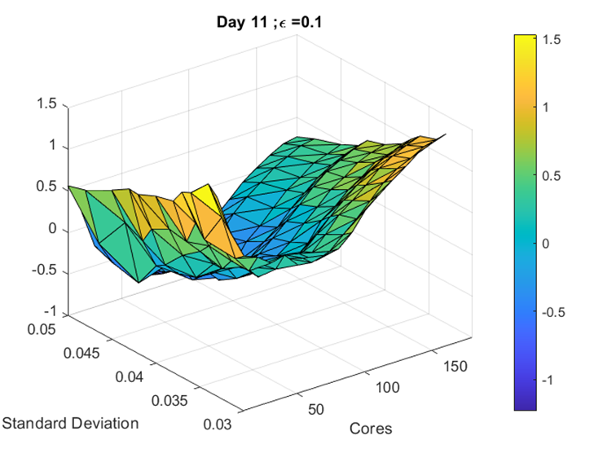
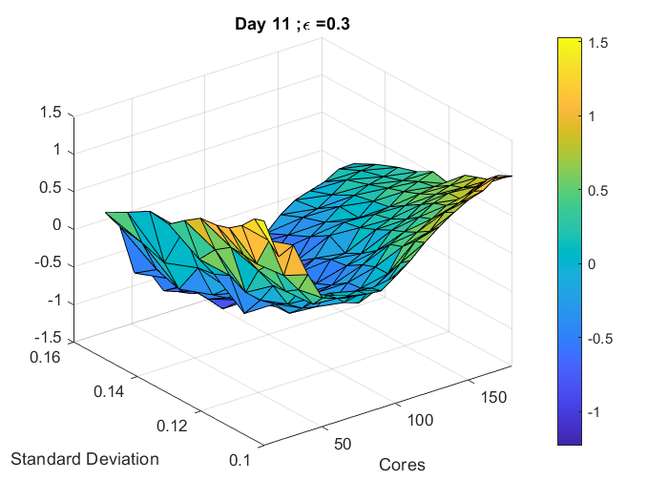
Heat Map Difference In Performance Ratio between ML algorithm and Greedy best fit : Day 11, Slack:0.1, 0.3

Slide 30
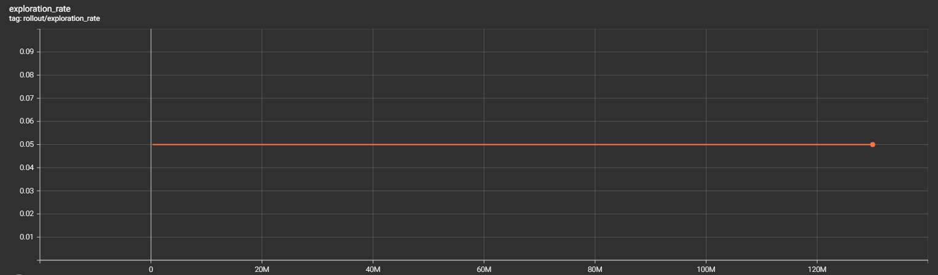
We observe that the exploration rate while training was constant. We have trained for more than 130 million timesteps and we understand that the reward mean converges to an almost constant range.

Slide 31
Conclusion And Future Scope
The results show that our ML approach is not effectively competitive against an offline optimal algorithm in the average case in terms of maximizing machine utilization.
The results of the lower number of machines (resources) gives a slight hope that the algorithm may work better in worst case scenarios. Further testing in tailor made worst case scenarios required.
Whenever a new job is provided, the scheduling decision will be heavily influenced by the current state of the schedule/machine as well as the nature of the new job (which may not follow a historical pattern).

Slide 32
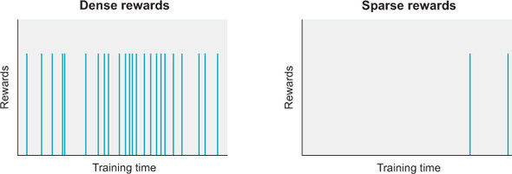
The proposed method employs a dense reward strategy, it attempts to map the current machine state and job locally, make a decision, and issue a reward at each step, without considering the larger picture.
A sparse reward strategy, in which the full timeline is examined as a whole and incentives awarded proportionally at the end, is an alternative for the future.

Slide 33
Contributions
Implementation of required python functions by: Philip Varghese Modayil and Abdulkader Motorwala.
Adaption of CartPole-v1 environment by: Philip Varghese Modayil and Abdulkader Motorwala.
Conception and implementation of observation space with machine states: Philip Varghese Modayil and Abdulkader Motorwala.
Conception and implementation of five number summary / box plot for observation space by: Philip Varghese Modayil.
Conception and implementation of profitability criterion for reward scheme by: Philip Varghese Modayil.
Running training and testing cycles by: Philip Varghese Modayil.
Result and report by: Philip Varghese Modayil.

